Slide 1


Let me introduce myself…

Slide 2
Blancrème website

Slide 3
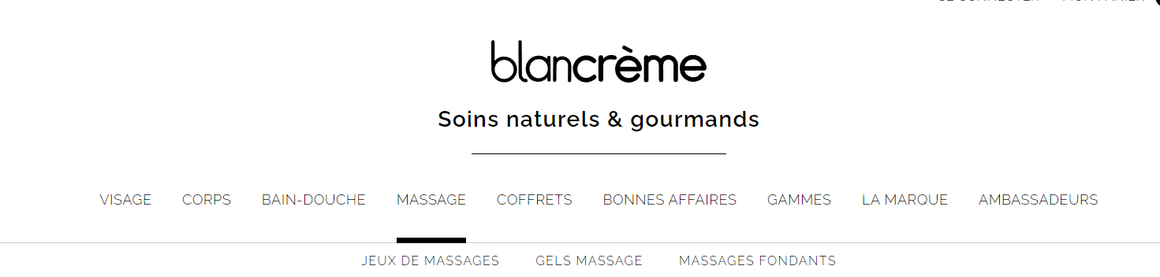


Content
Menu
Contact info
Slider

Slide 4
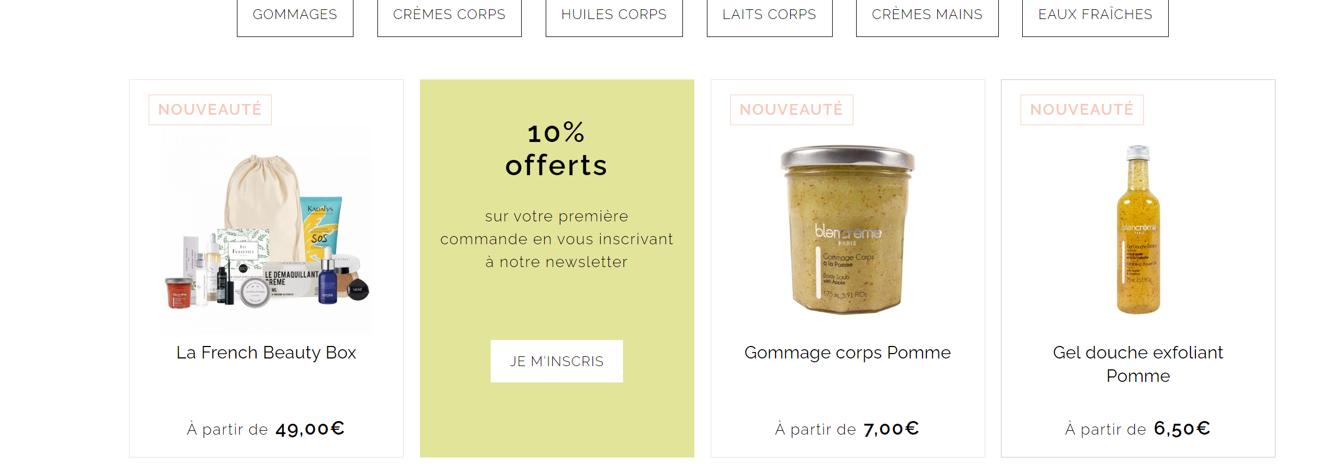
Navigation menu

Slide 5

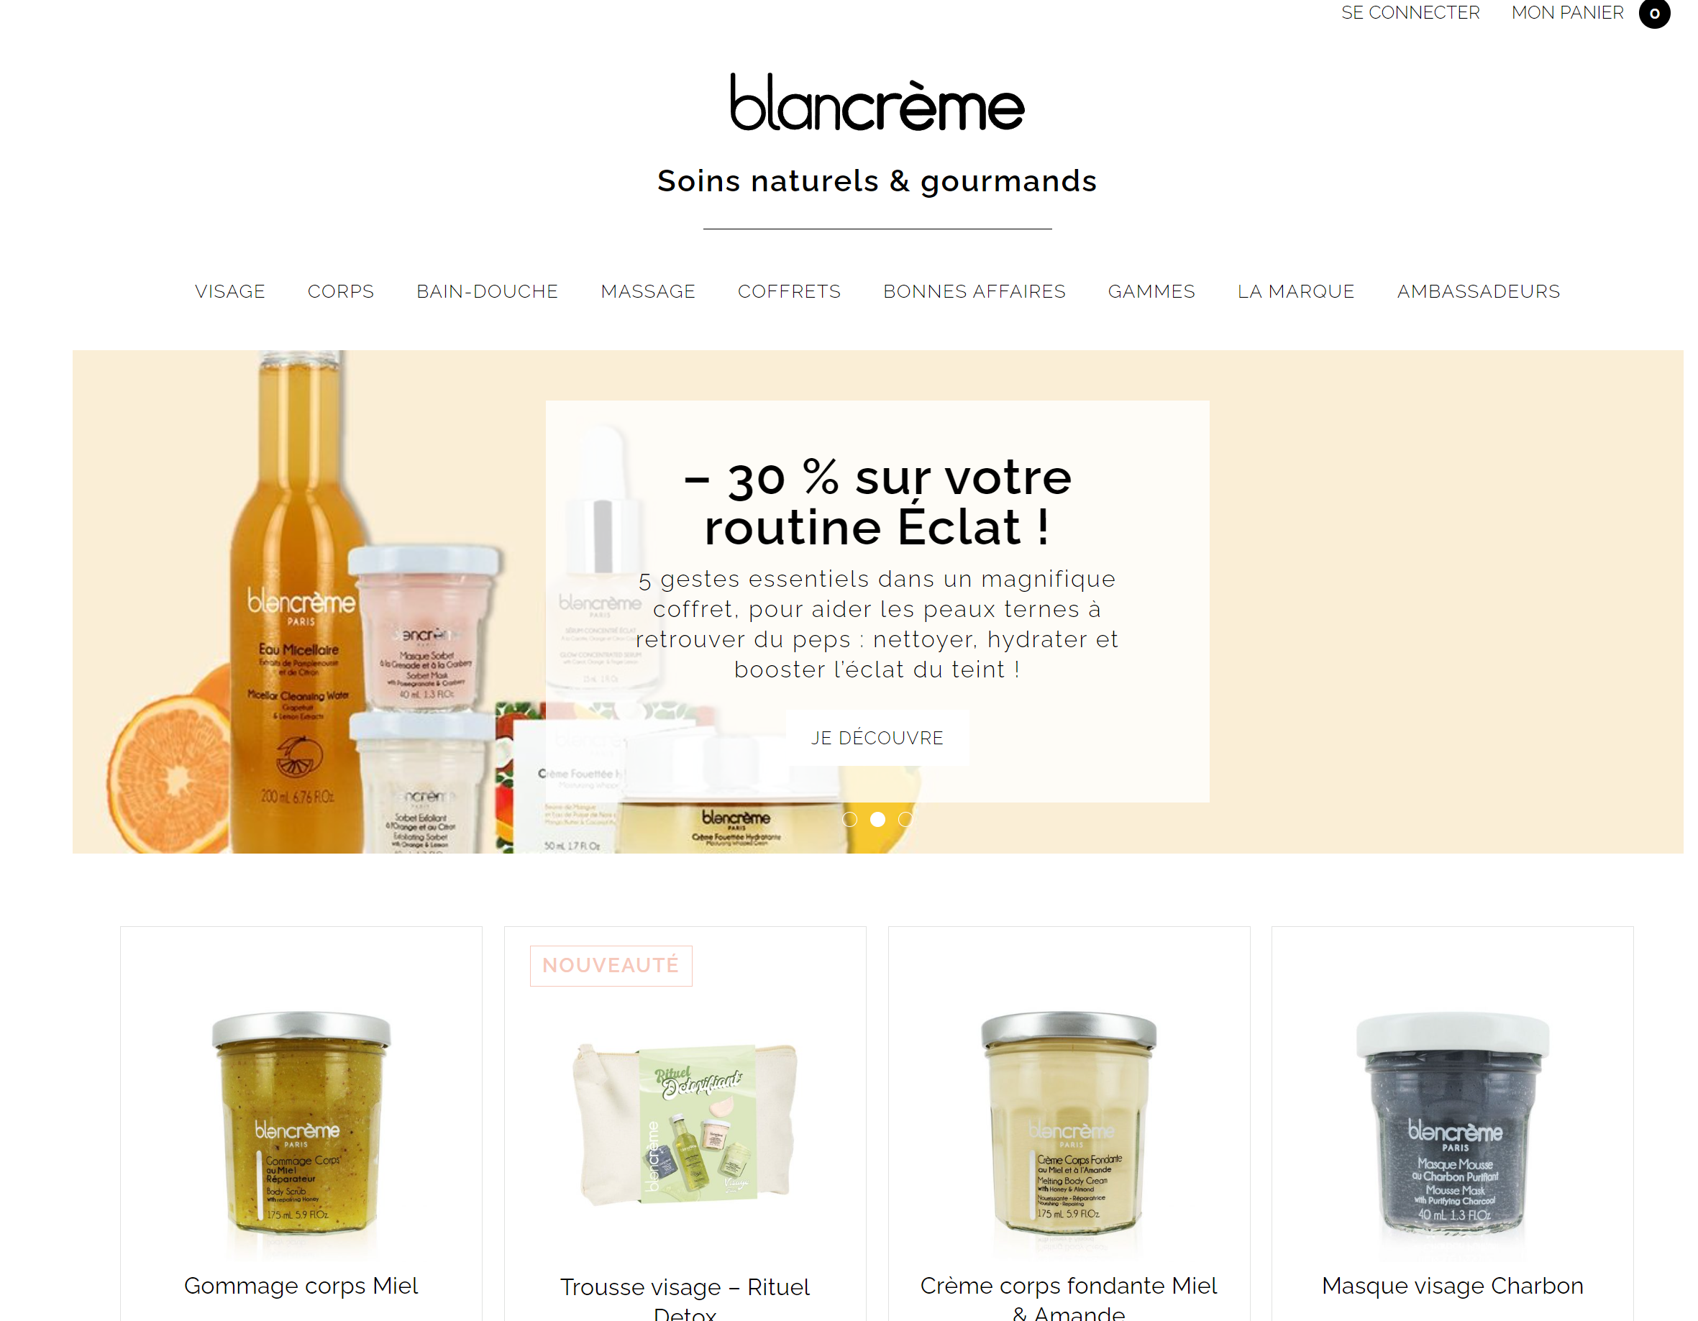
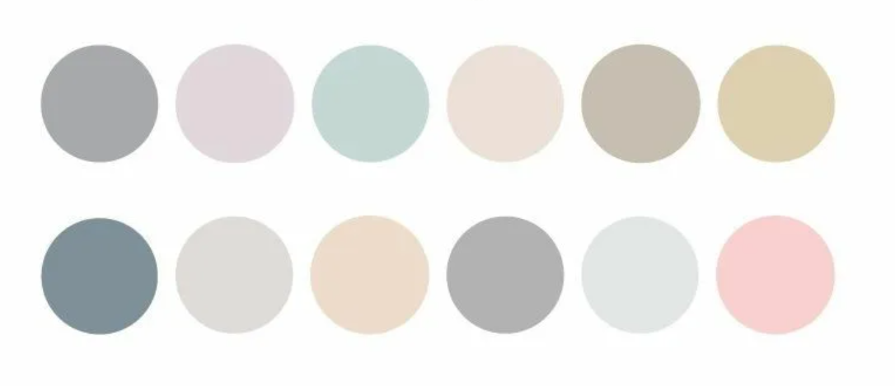
Color scheme
Main color: white
more attention to products and content
a sense of calm
Neutral colors
relaxed and pleasant atmosphere

Slide 6
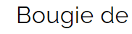



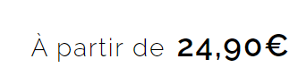
Typeface – font awesome brands 6

Slide 7



Animated objects
Links
dynamic and enjoyable
Images
Slider

Slide 8
I’ll be glad to answer your questions

Slide 9
Thanks for attention

